Slide 1
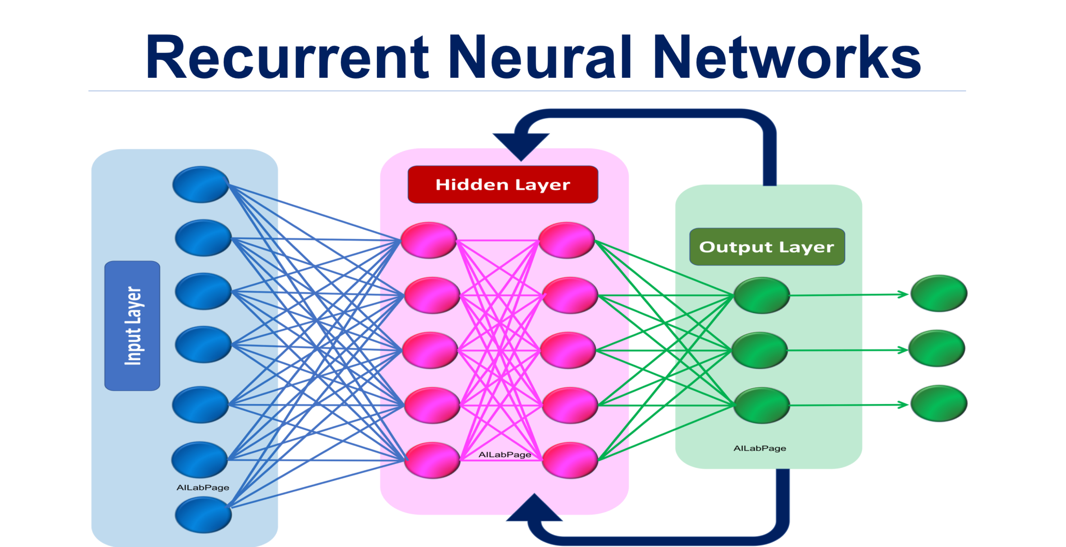
Abhilash Saj
Kiran M
S4 – MCA

Slide 2
Topics
Sequence to Sequence Modelling
Intro to RNN
Working of RNN
Applications
Advantages
Disadvantages
Project - Making Your Model Learn Addition!

Slide 3
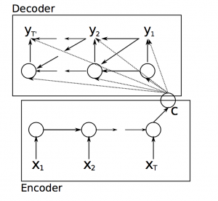
Sequence to Sequence Model
A typical sequence to sequence model has two parts – an encoder and a decoder. Both the parts are practically two different neural network models combined into one giant network.
Broadly, the task of an encoder network is to understand the input sequence, and create a smaller dimensional representation of it. This representation is then forwarded to a decoder network which generates a sequence of its own that represents the output

Slide 4
RNN Introduction
Recurrent Neural Network(RNN) are a type of Neural Network where the output from previous step are fed as input to the current step.
In traditional neural networks, all the inputs and outputs are independent of each other, but in cases like when it is required to predict the next word of a sentence, the previous words are required and hence there is a need to remember the previous words.
Thus RNN came into existence, which solved this issue with the help of a Hidden Layer.

Slide 5
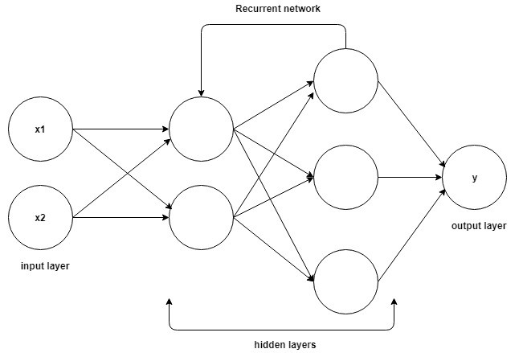
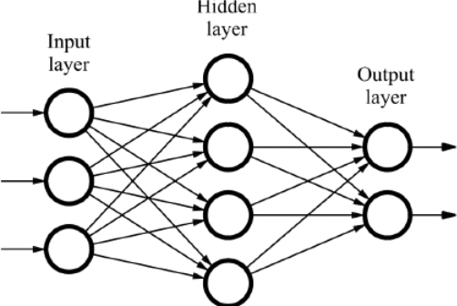
Example
Consider these 2 reviews
This movie is not terrible at all
This movie is pretty decent

Slide 6
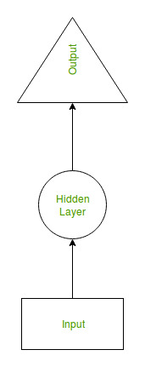
Hidden Layer
The main and most important feature of RNN is Hidden state, which remembers some information about a sequence.
RNN have a “memory” which remembers all information about what has been calculated. It uses the same parameters for each input as it performs the same task on all the inputs or hidden layers to produce the output.
This reduces the complexity of parameters, unlike other neural networks.

Slide 7
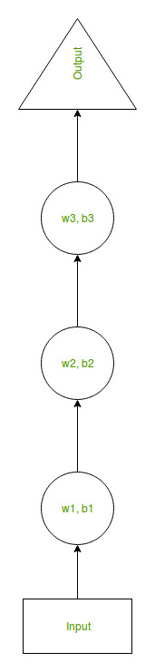
Working
Suppose there is a deeper network with one input layer, three hidden layers and one output layer.
Then like other neural networks, each hidden layer will have its own set of weights and biases, let’s say, for hidden layer 1 the weights and biases are (w1, b1), (w2, b2) for second hidden layer and (w3, b3) for third hidden layer.
This means that each of these layers are independent of each other, i.e. they do not memorize the previous outputs.

Slide 8
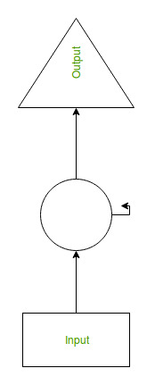
RNN converts the independent activations into dependent activations by providing the same weights and biases to all the layers, thus reducing the complexity of increasing parameters and memorizing each previous outputs by giving each output as input to the next hidden layer.
Hence these three layers can be joined together such that the weights and bias of all the hidden layers is the same, into a single recurrent layer.

Slide 9
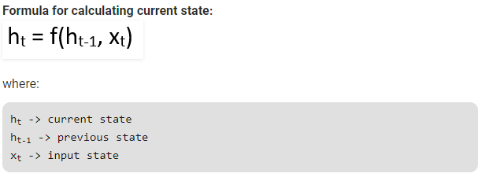
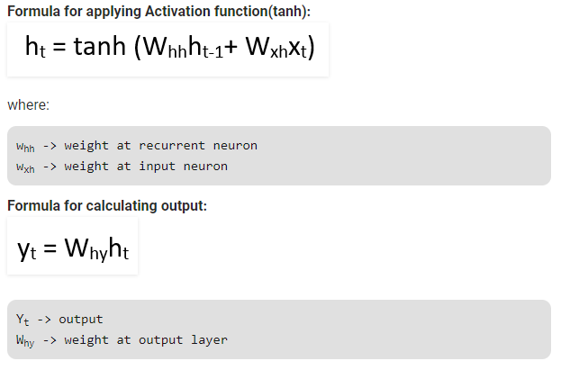

Slide 10
Training through RNN
A single time step of the input is provided to the network.
Then calculate its current state using set of current input and the previous state.
The current ht becomes ht-1 for the next time step.
One can go as many time steps according to the problem and join the information from all the previous states.
Once all the time steps are completed the final current state is used to calculate the output.
The output is then compared to the actual output i.e the target output and the error is generated.
The error is then back-propagated to the network to update the weights and hence the network (RNN) is trained.

Slide 11
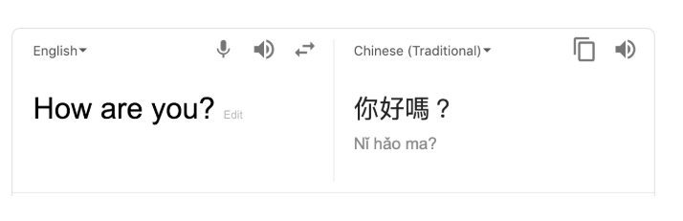
Applications of RNN
Prediction problems
Language Modeling and Generating Text
Machine Translation
Speech Recognition
Text Summarization

Slide 12
Advantages
An RNN remembers each and every information through time. It is useful in time series prediction only because of the feature to remember previous inputs as well. This is called Long Short Term Memory.
Recurrent neural network are even used with convolutional layers to extend the effective pixel neighborhood.

Slide 13
Disadvantages
Gradient vanishing and exploding problems.
Training an RNN is a very difficult task.
It cannot process very long sequences if using tanh or relu as an activation function.

Slide 14
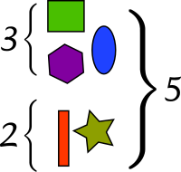
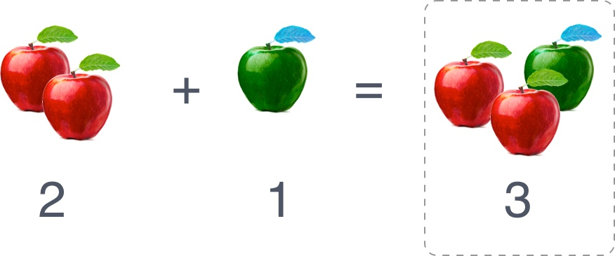
Making Your Model Learn Addition!
Given the string "54+7", the model should return a prediction: "61"

Slide 15
Objectives
Create, train and evaluate a recurrent neural network model.
Train a sequence to sequence recurrent net to be able to solve simple addition equations given in string format.

Slide 16
Project breakup
Introduction
Generate Data
Create the Model
Vectorize and De-Vectorize Data
Create Dataset
Training the Model
Testing
https://github.com/abhilashsaj/Simple-Recurrent-Neural-Network-with-Keras

Slide 17
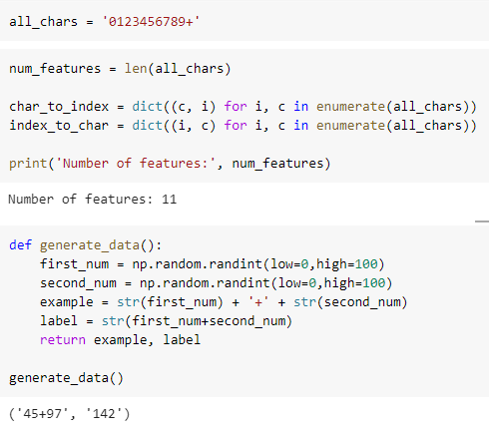
Generate Data

Slide 18
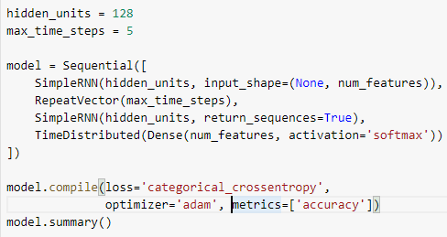
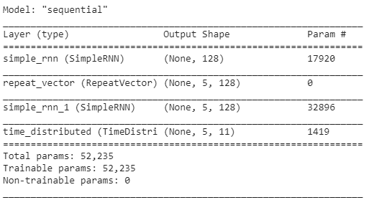
Create the Model

Slide 19
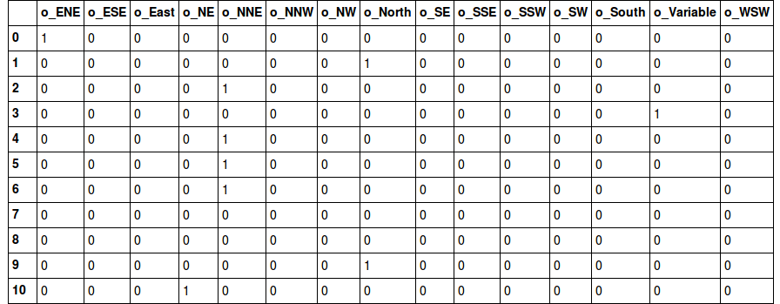
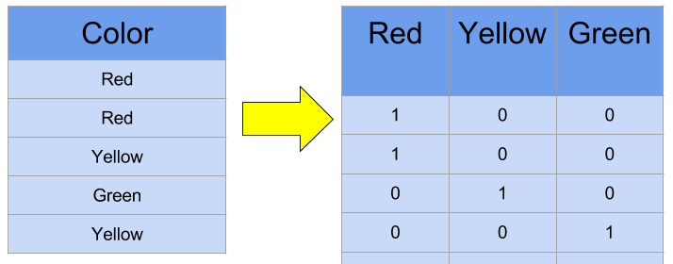
One Hot Encoding

Slide 20
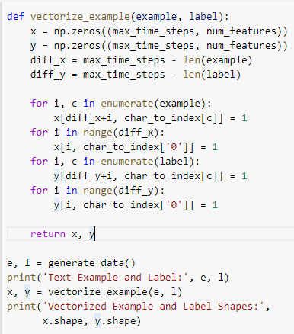

Vectorize and De-Vectorize Data

Slide 21
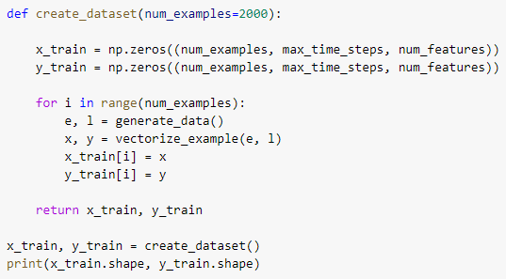
Create Dataset

Slide 22
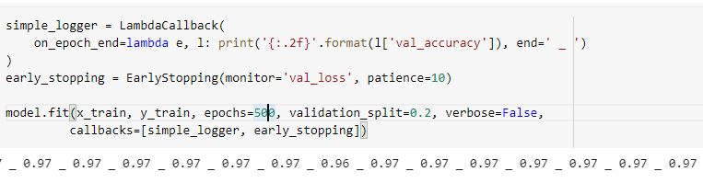
Training the Model

Slide 23
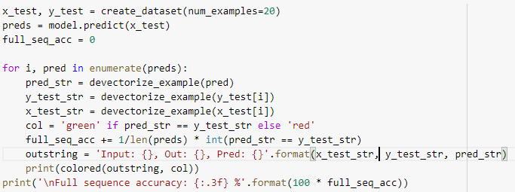
Creating testset for predicting

Slide 24
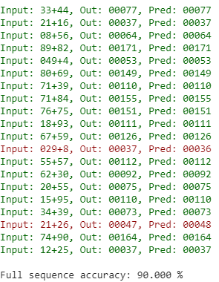
Prediction

Slide 25
Summary
Sequence Modeling is the task of predicting what word/letter comes next.
RNN is trained to map an input sequence to an output sequence which is not necessarily of the same length.
Applications are speech recognition, machine translation, image captioning and question answering.
An RNN remembers each and every information through time.
Gradient vanishing and exploding problems.
Training an RNN is a very difficult task.
https://github.com/abhilashsaj/Simple-Recurrent-Neural-Network-with-Keras

Slide 26
Thank You.

